Slide 1



Data Analytics in HR
NIVT

Slide 2

Group
Prasenjit Karmakar
Sabyasachi Roy
Sagar Roy
Yasar Reza Rahaman

Slide 3
Introduction
Human resource management(HRM) is an operation in companies designed to maximize employee performance in order to meet the employer’s strategic goals and objectives. More preciously HRM focuses on management of people within companies, emphasizing on policies and systems.
In short, HRM is the process of recruiting, selecting employees, providing proper orientation and induction, imparting proper training and developing skills.

Slide 4
History
Early Stages
Evidence of workers
Schools at factories.
1900-1960
Personnel department
Strict work safety introduced
1960-Today
Business partnership
War of talents
Hiring new employees
Voluntary introduction of social programs by factories
First work safety laws implemented
Basic hard skills training
Trade unions
Social programs for employees
Hard skill training
Productivity focus
HRIS
Soft skills
Talent development
Outsourcing
Leadership
Diversity
Innovation
In 18th century the concept of HR first emerge.

Slide 5

Data Science ?
Data Science is the area of analyzing the data that we generate every day with the help of statistical tools and mathematical concepts in order to improve our daily lives or to improve our economical circumstances.

Slide 6
Components of Data Science
Data Management
Data Analytics
Artificial Intelligence

Slide 7

Data Analytics?
Data Analytics is the process of examining the
datasets in order to draw conclusion about the information it contains.

Slide 8
Types of Analytics
Descriptive Analytics
Predictive Analytics
Prescriptive Analytics

Slide 9

Man Vs Machine

Slide 10

Why Machine Wins ?
Machine wins because they have tremendous processing speed as compared to humans and they can also Generalize on large amount of data.

Slide 11

Friendship

Slide 12
Why Python ?

Slide 13




Data Management & Manipulation packages

Slide 14
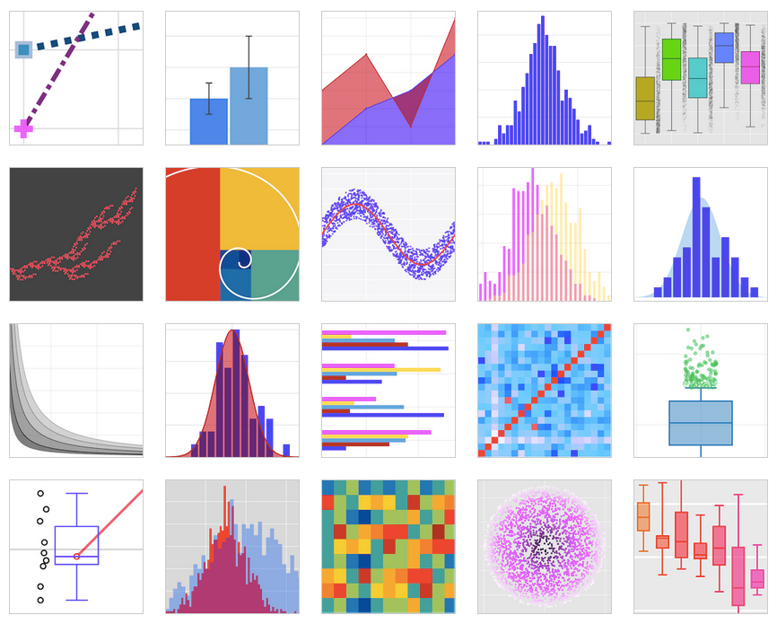

Data Visualization packages

Slide 15




Excellent Packages for Statistical Models

Slide 16
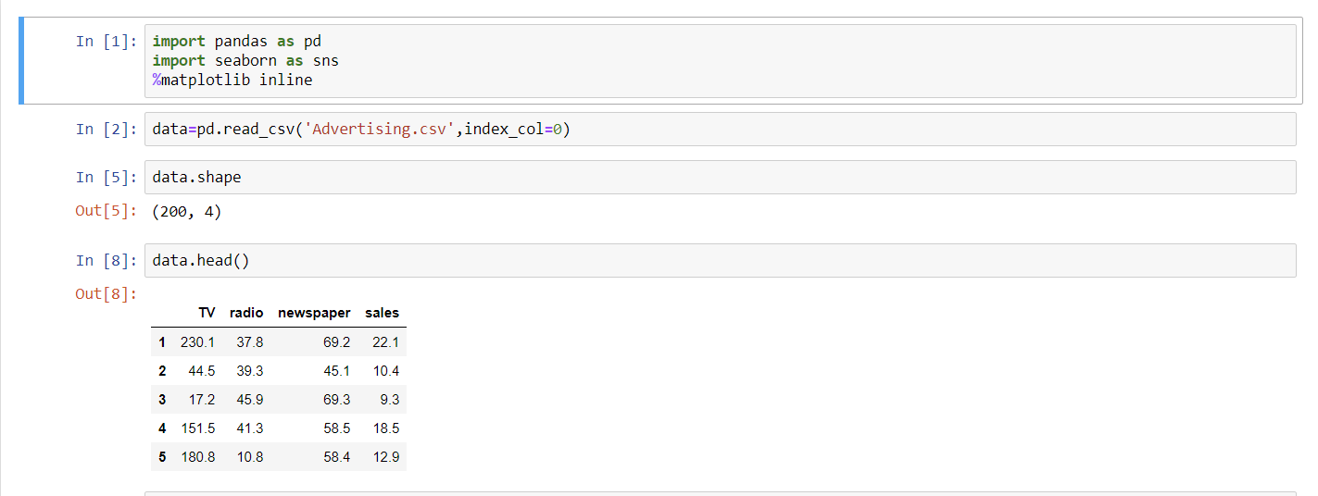

Excellent interpreter: JUPYTER

Slide 17

Role of Data Science in HR data analytics
Recruiting the right employees
Competition and promotion
Benefit analysis
Resignation prediction

Slide 18
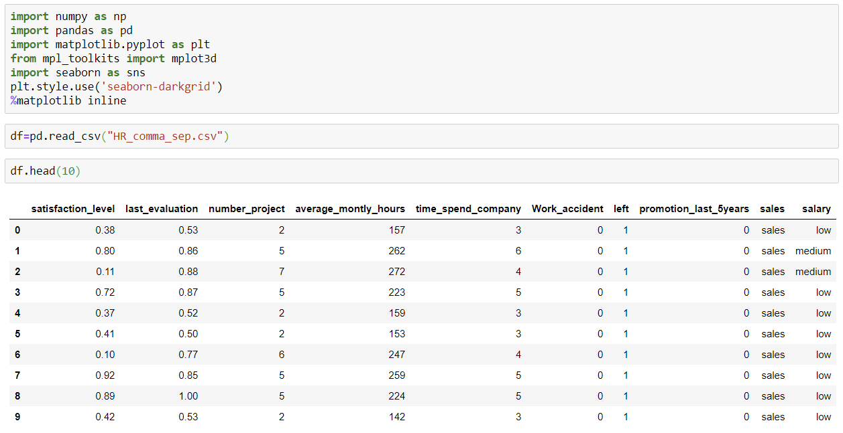
Dataset where about
This dataset “HR_comma_sep.csv” is originally belongs to IBM.
It has 10 columns and 14999 rows for their employees.

Slide 19
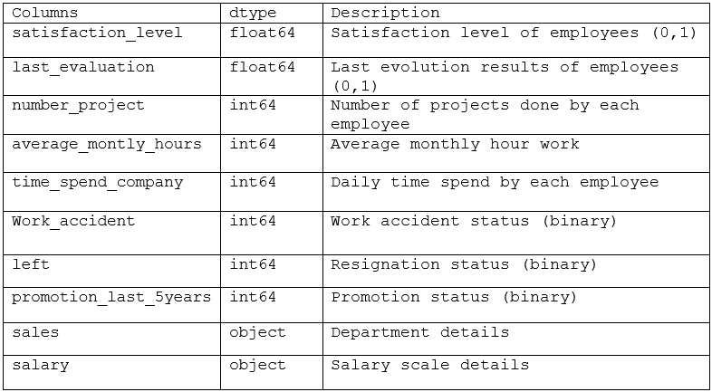
Column description

Slide 20

Goal
Our main goal is to predict whether an employee would quit his job or not and try to advice the employer about that.

Slide 21
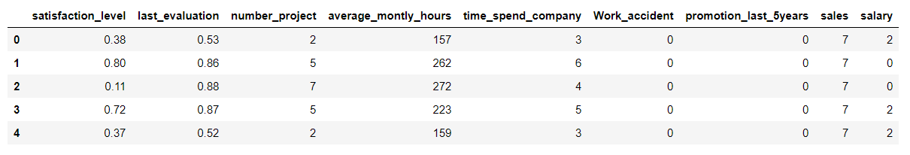
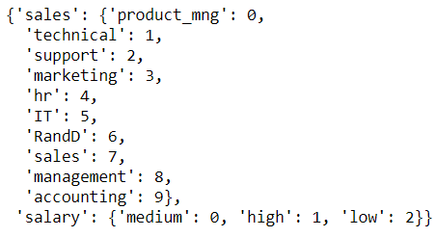
features
Categorical features “sales” and “salary” are encoded by the dictionary

Slide 22
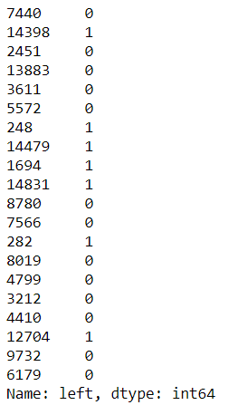
label
It is only a column that contains whether an employee quit his job or not.
1 : quitted
0 : currently working

Slide 23
Used python Libraries

Slide 24

Information from the dataset

Slide 25
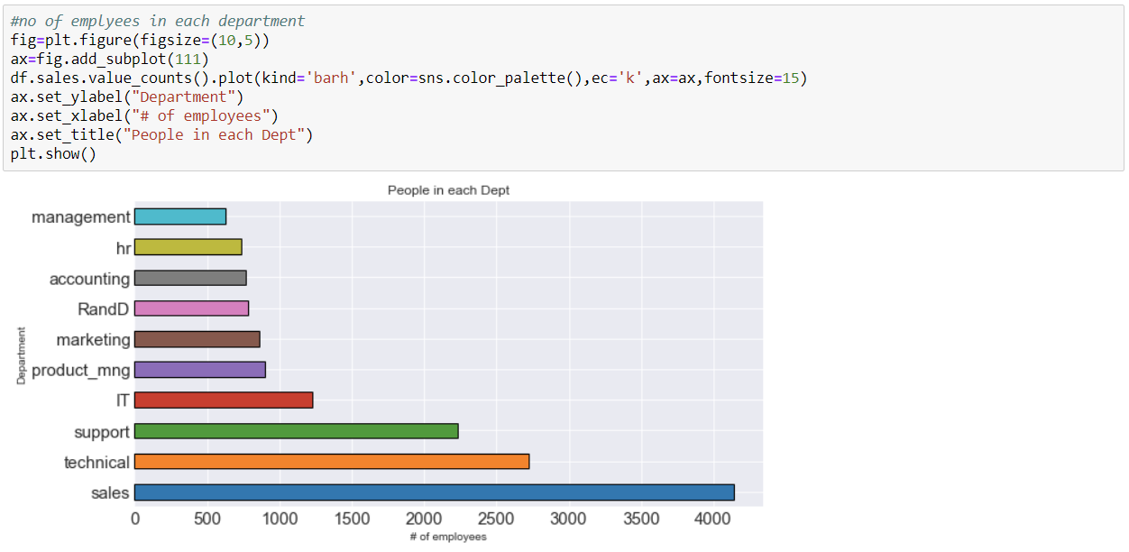
How many employees are in each department ?

Slide 26
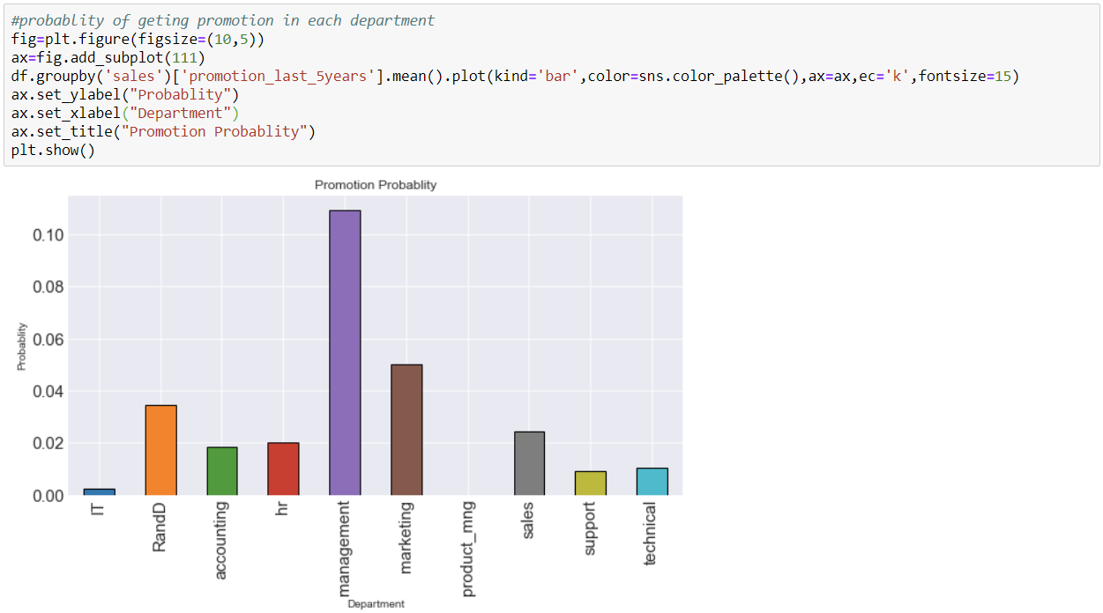
Probabilities of getting promotion in each department

Slide 27
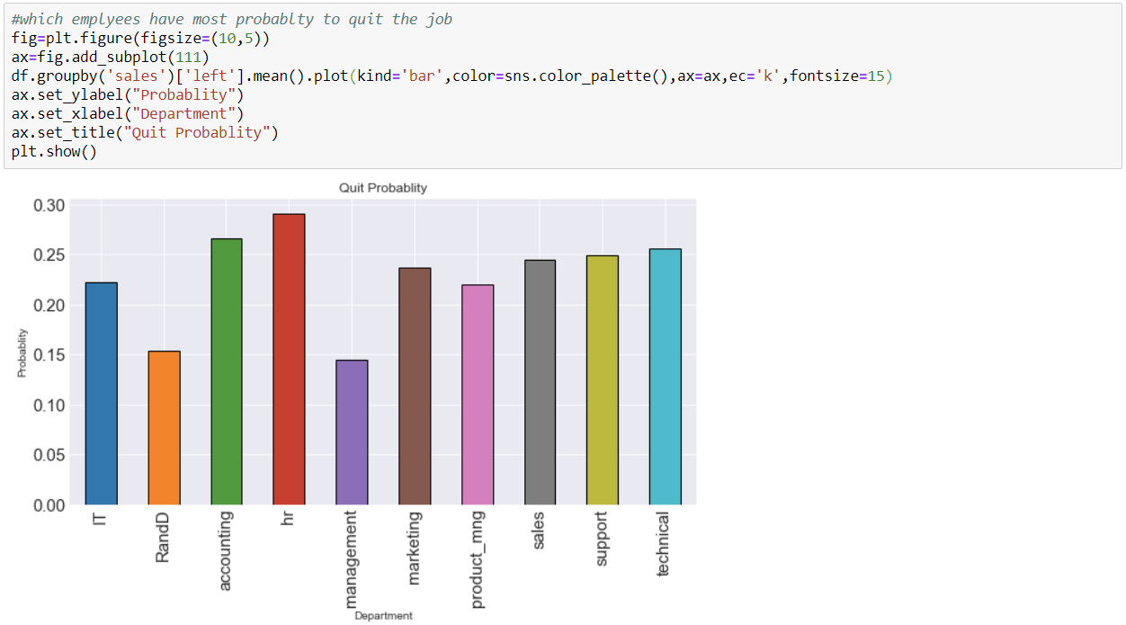
Probabilities of quitting jobs in each department .

Slide 28
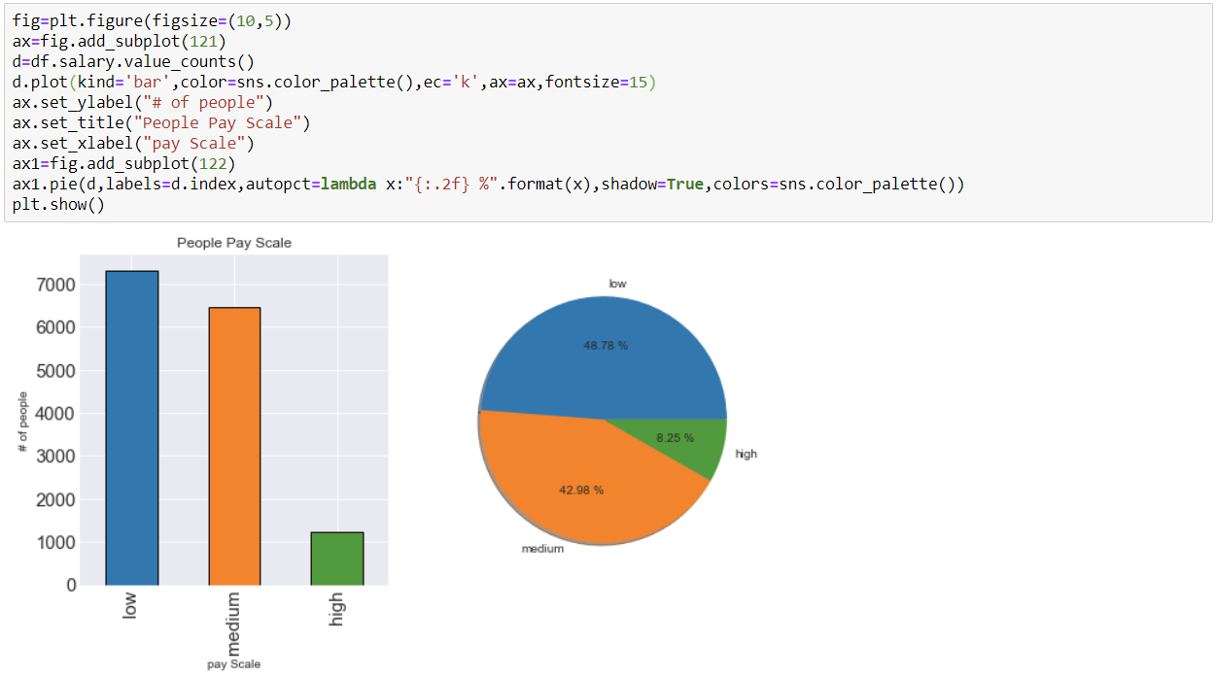
Pay Scale of employees

Slide 29
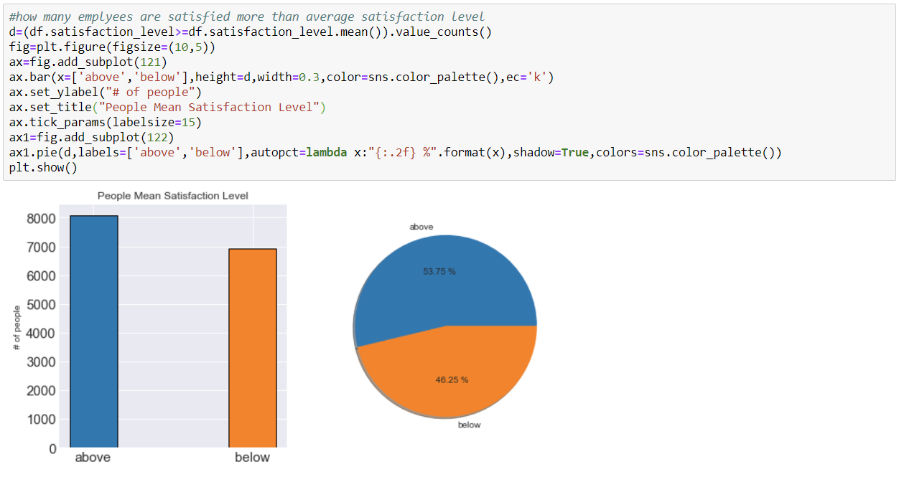
Employees satisfaction level

Slide 30
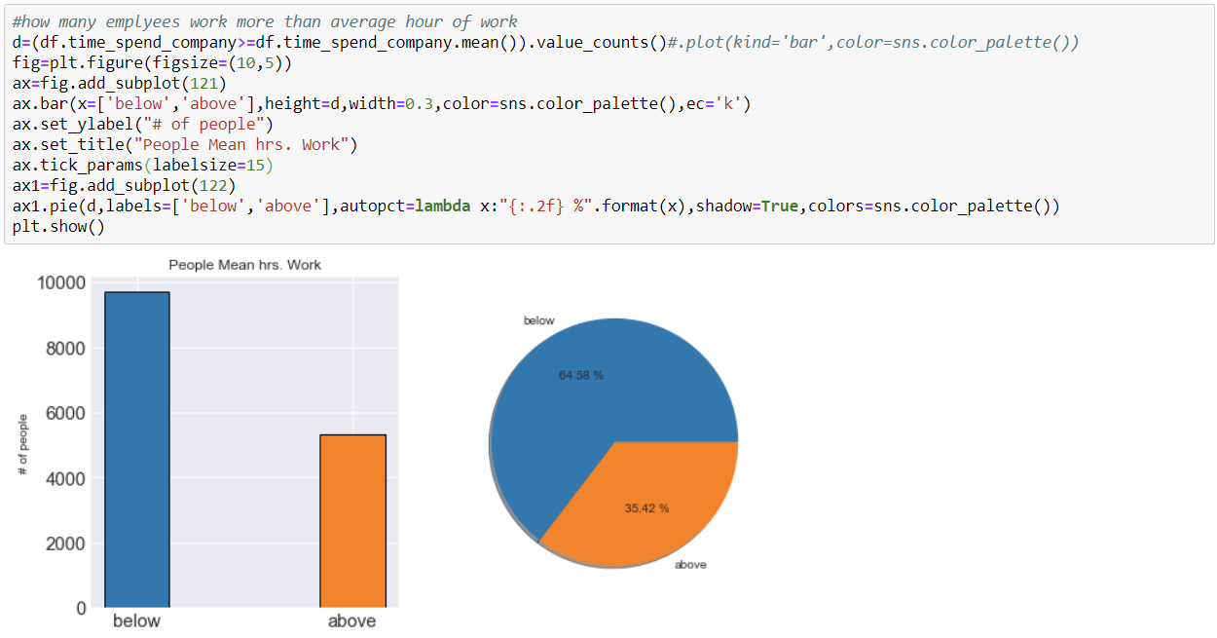
How much employees work everyday ?

Slide 31
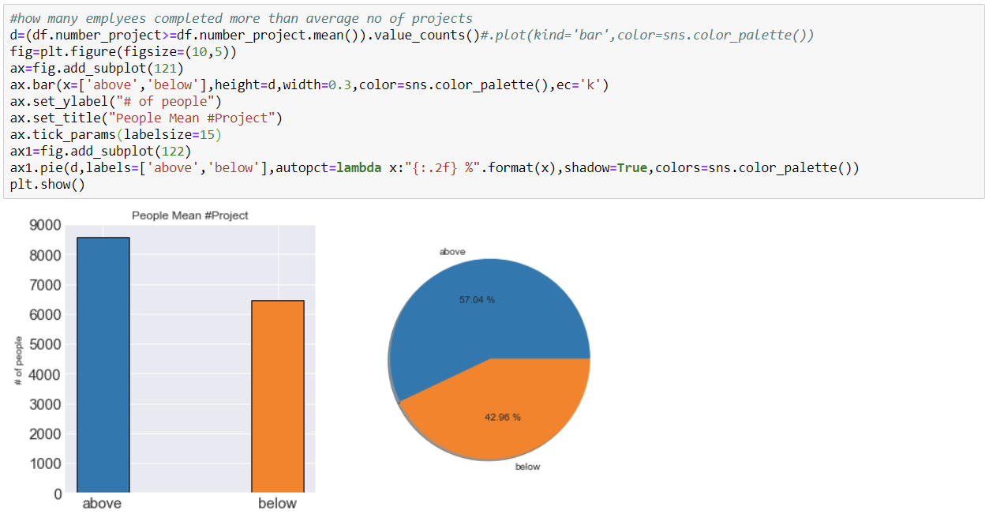
Employees Project Work

Slide 32
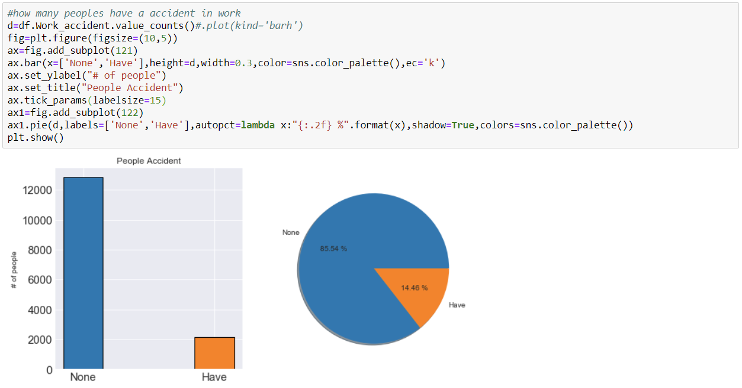
How many employees have accident in work ?

Slide 33
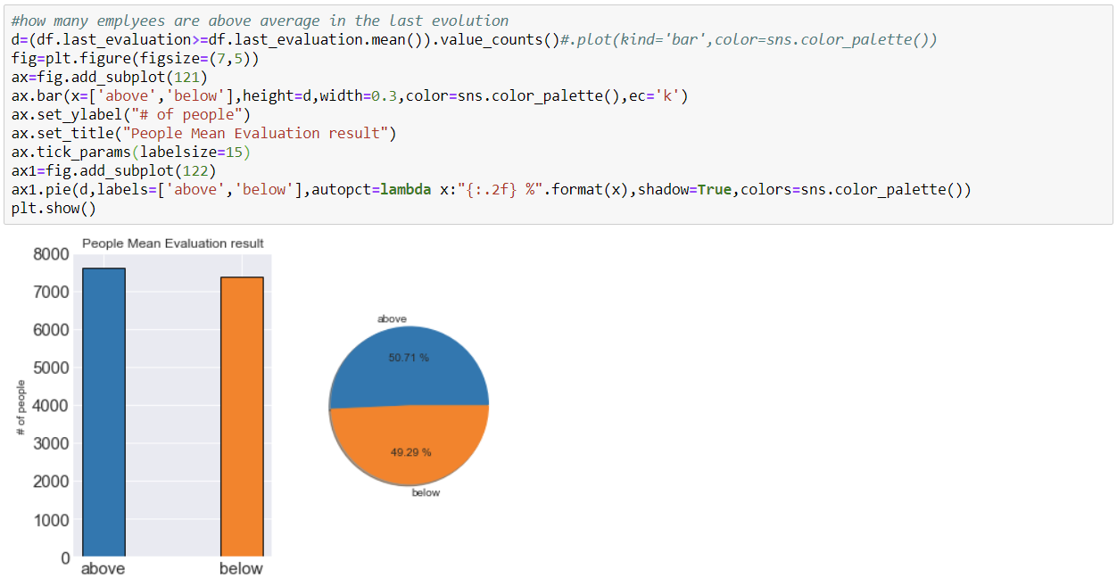
Last Evaluation Results

Slide 34
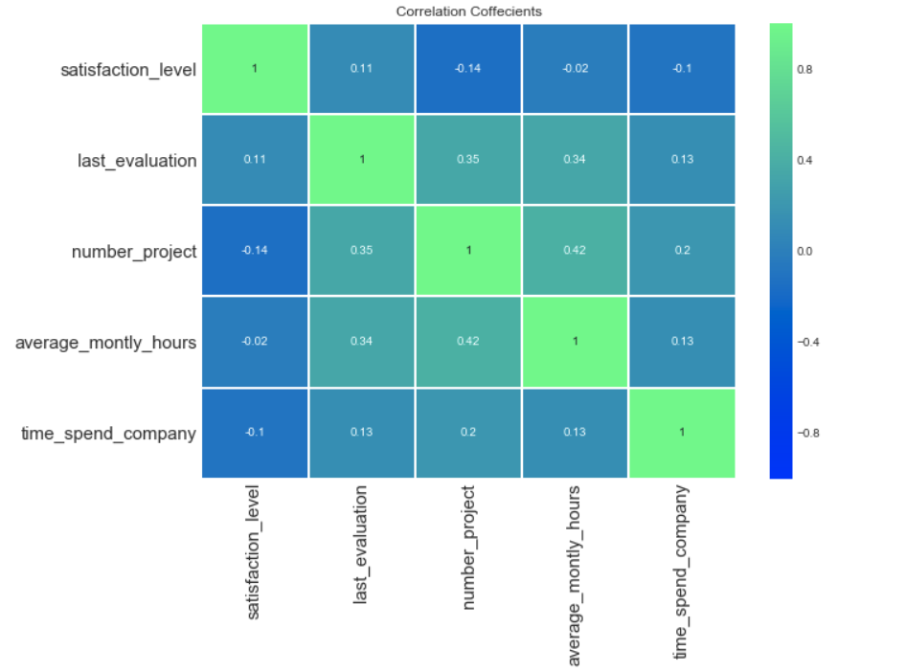
Correlation between numeric features

Slide 35
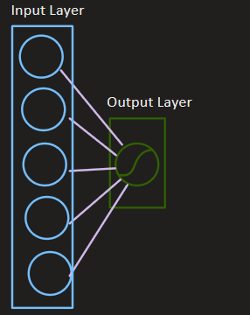
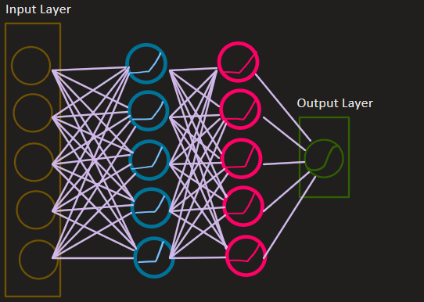
Our Statistical Approaches
Logistic Regression
Artificial Neural Network

Slide 36
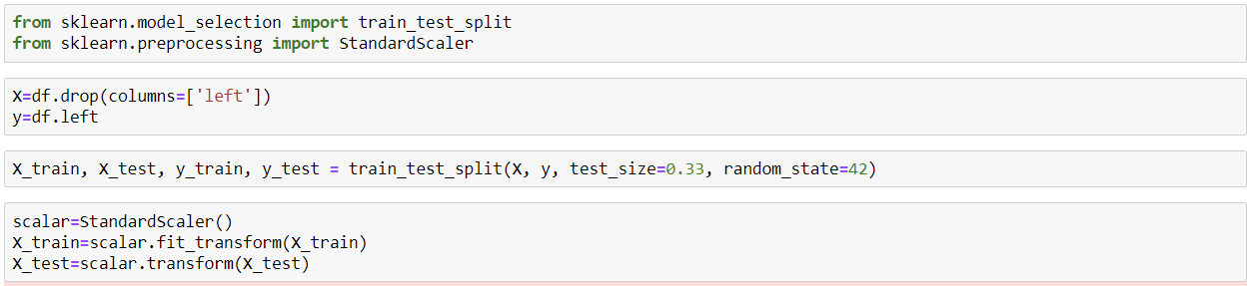
Data Preprocessing
The dataset is split into training and testing part and scaled with Standard Scaler

Slide 37
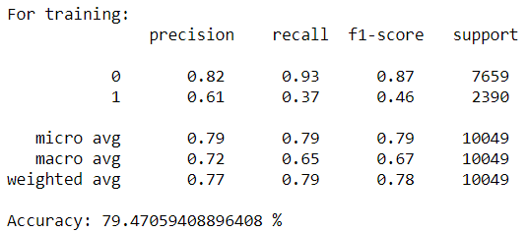
Training: Logistic Regressor
Here we can see that the training accuracy of the Logistic Regressor is 79%

Slide 38
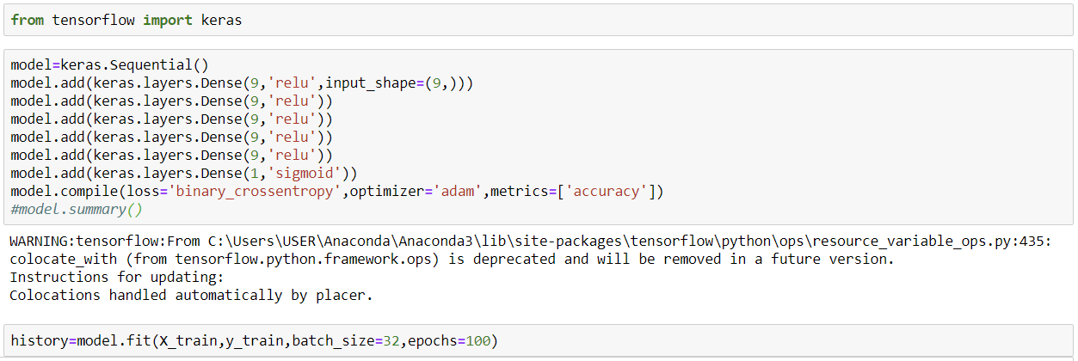
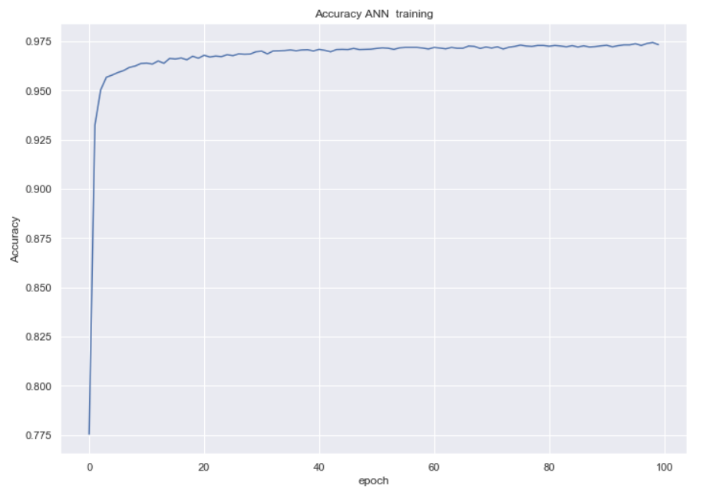
Training: ANN
Here we can see that the training accuracy of the ANN reaches to 97.5%

Slide 39
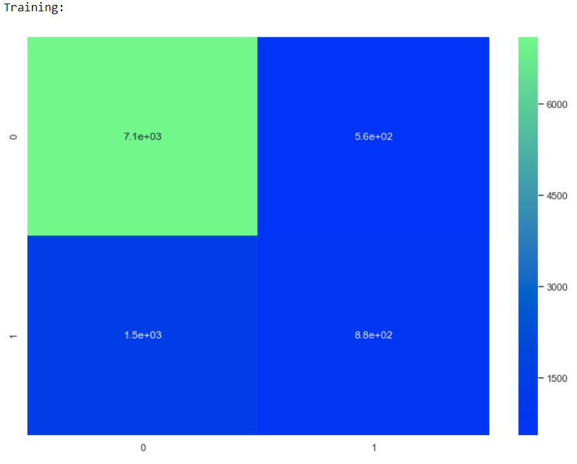
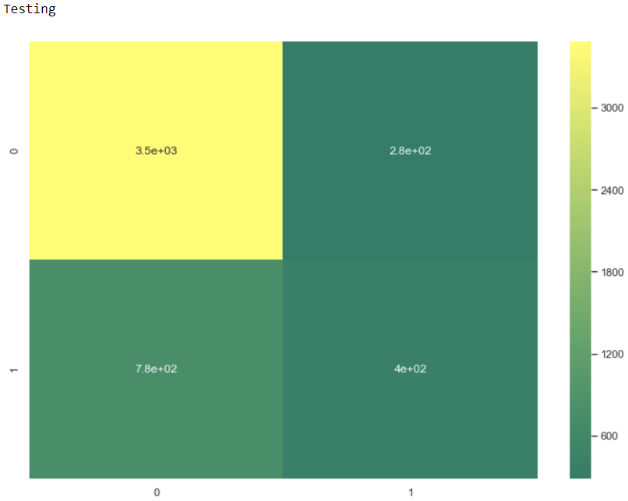
Accuracy: Logistic Regression
Training Accuracy: 79.5 %
Testing Accuracy: 78.5 %

Slide 40
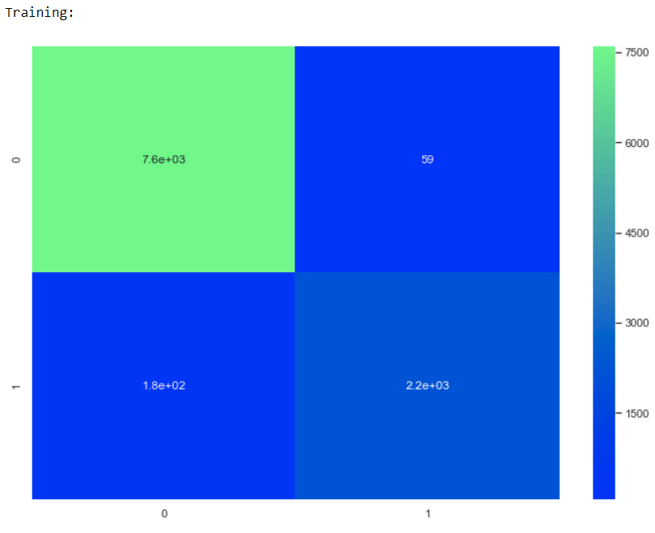
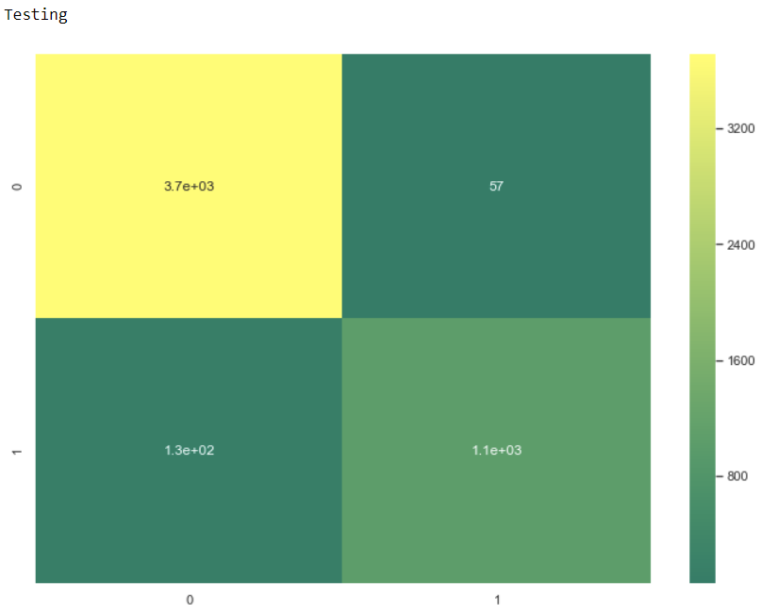
Accuracy: ANN
Training Accuracy: 97.6 %
Testing Accuracy: 96.3 %

Slide 41
What is better Approach ?
ANN has better approach than Logistic Regression because it has better accuracy compared to Logistic regression.
ANN is more superior statistical model than Logistic Regression.

Slide 42

Decision Making
Human Resource Management is all about the decision making. And here we can advice a company whether to recruit an employee or whether an existing employee will stay or leave the company.

Slide 43
Benefits for the Company
Using HR analytics we can select perfect employees for the company.
We can find out the probability of employees who can left the job in future.
We can find out the satisfaction level of employees.
We can take safety equipment for better employment.
Can derive ideal time for job.
Can find out work value per capita.

Slide 44
Conclusion
So we can conclude that by using data science we can help an organization to take economic and crucial decisions to increase their profit as well as increase their employee’s motivations by stress management techniques.

Slide 45
Acknowledgement
We are very grateful to NIVT and specially to Tania Chakraborty to assign us this project and guide us through this training course “ Data Analytics With PYTHON ”. It was very helpful for our learning.

Slide 46
Any Query ?

Slide 47
The End

